Slide 1
DEVELOP AN OUTCOME L2
Evidence of Learning Template
0136001211
Movie Quiz (Braydon’s Code)
Braydon Faauuga

Slide 2
Github /Drive link
Trello board or PM link
You MUST provide evidence showing how the problem has been decomposed, how the components have been developed and trialled, and of how they have been assembled and tested to create a final, working outcome.

Slide 3
Project management: Setup
Record evidence that you have setup project management tools to manage the development of your outcome.
Record evidence that you have chosen project management techniques to manage the development of your outcome.
Record evidence that you have setup/ chosen version control tools/techniques to manage the development of your outcome.
Explain why you believe that these tools and techniques are appropriate for the development of your outcome.

Slide 4
Project Management Tools
Here I have used a website called Monday.com to plan out how I would work on my project as I didn’t give each task a certain amount of time to complete it in. It mainly was used like a reminder of each task. It was actually extremely helpful as the programme help me indicate and remind me on what I needed help as you can mark which task on what you need to prioritize the most. I was lucky to find this as I was about to use another tool called ProjectManager.com which was too much for me as it a gannat chart. I didn’t want to ensure that I had to follow through a schedule as I didn’t quite understand how to implement the use of dictionaries in my project. I would have used in Trello as it had the same concept as Monday.com but Monday.com had a system where you grade the work to see how far you are in each task.That was beneficial for me cause each time as I would see the chart and put work on ones that I thought were worked on enough.

Slide 5
Project Management Techniques
This shows that I used the Kanban method as it was the easiest method out of the them because in my screenshots. This method is mainly just made up of three ideas which make a project easy to plan. ”To - Do”,”Doing” and “Done”. These key factors helped remind me on which components of my project that I should work on. I had also used other techniques such as sharing with my classmates as we had few mistakes in our code that other can easily see which made progress go faster. While other helped by criticizing the code and telling us their feelings and views which we then tried to integrate into our codes. Another was scheduling as I did set dates for when I should start on a certain task but I tried to keep it as flexible as I could be as I had other tasks that were either more time consuming or just more harder than the task I had planned to do.

Slide 6
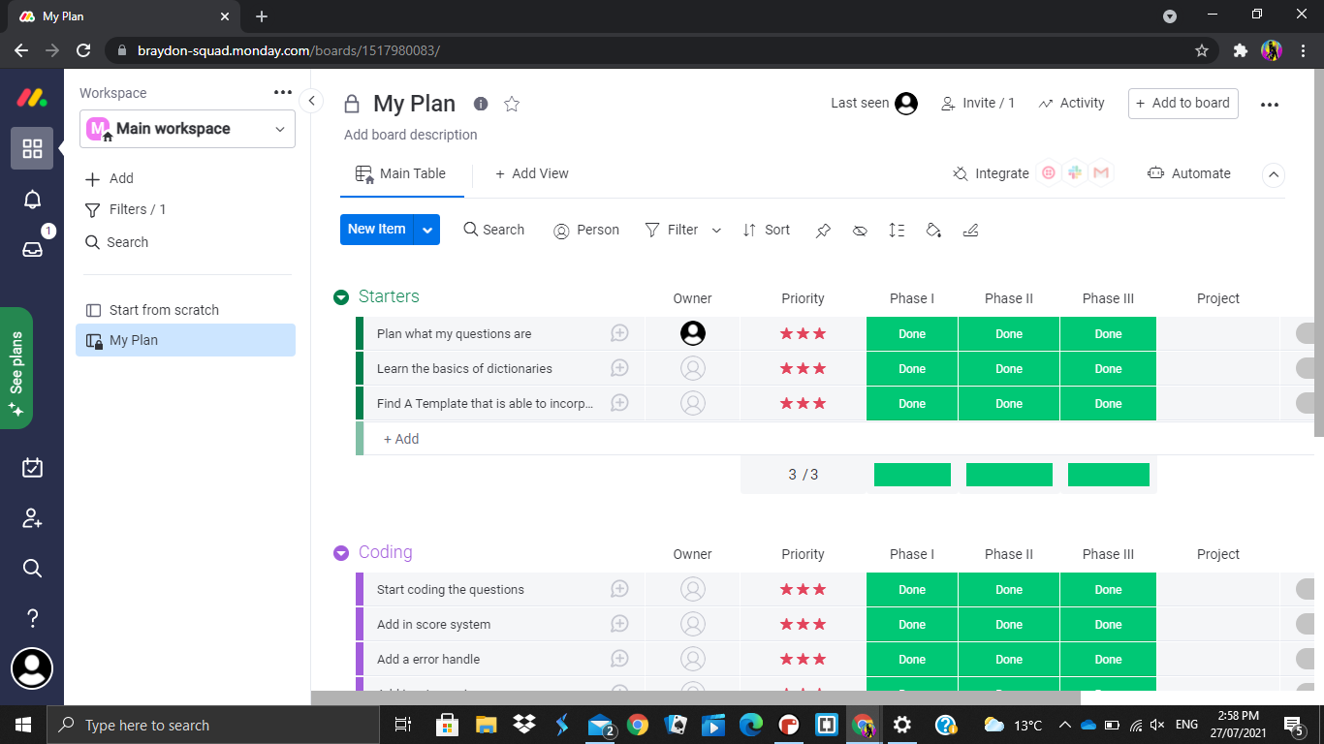
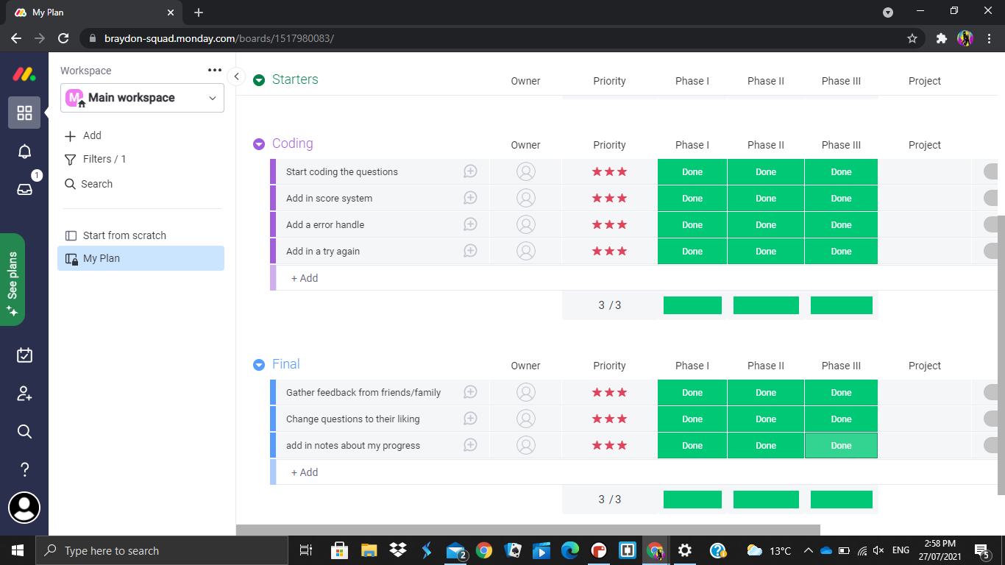
Project management Tools

Slide 7
Decomposing outcome
Record evidence that you have broken the outcome into smaller components.

Slide 8
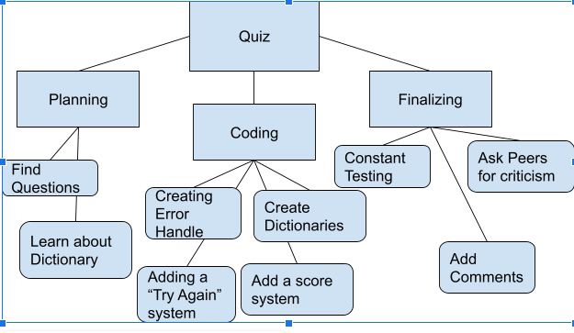
Mind Map

Slide 9
The Dictionaries
In my code, I used Dictionaries which is when you store data values using keys which made it easier to print whole questions with a single letter/word as trying to print it normally was more difficult and annoying as you would constantly try to fix indentation as it only allows 88 characters on a single line so breaking it up would take up so much time. I made sure that the each key corresponds with the button that needs to be pressed.

Slide 10
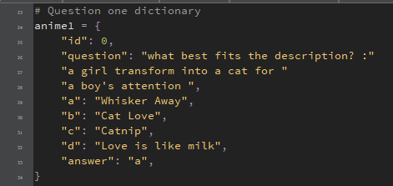
Dictionary 1

Slide 11
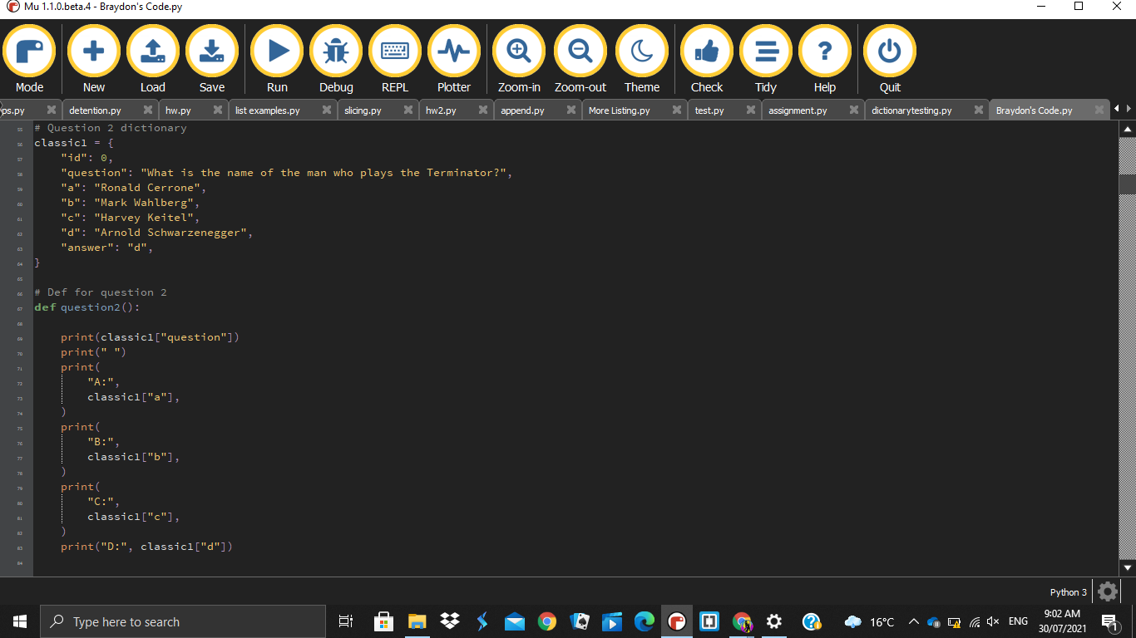
Dictionary 2

Slide 12
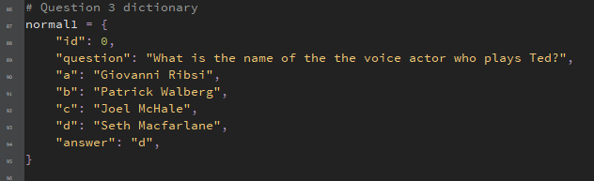
Dictionary 3

Slide 13
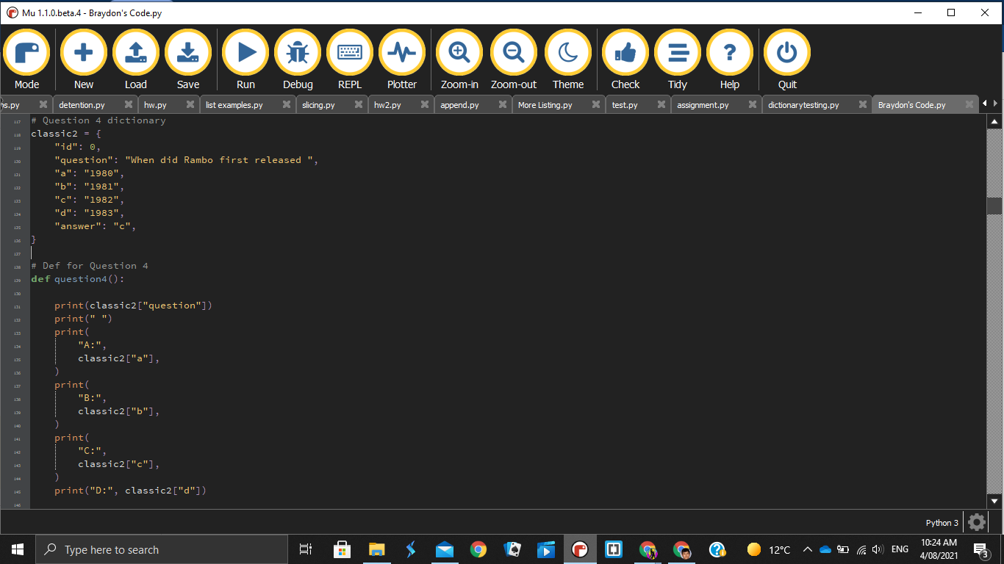
Dictionary 4

Slide 14
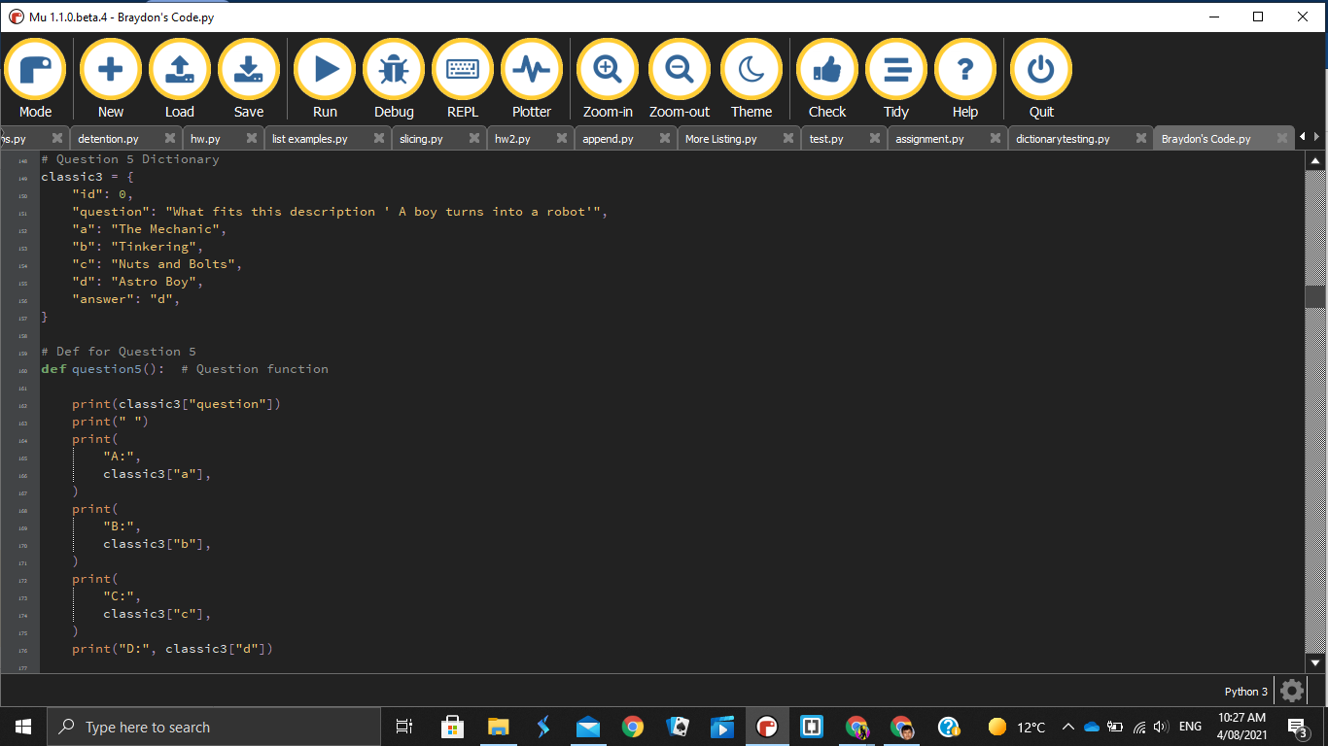
Dictionary 5

Slide 15
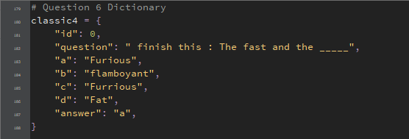
Dictionary 6

Slide 16
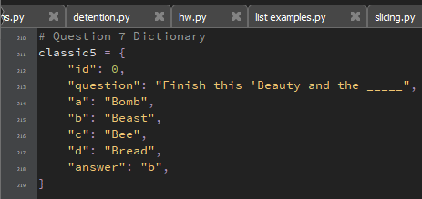
Dictionary 7

Slide 17

Dictionary 8

Slide 18
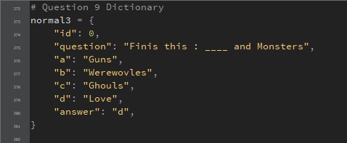
Dictionary 9

Slide 19
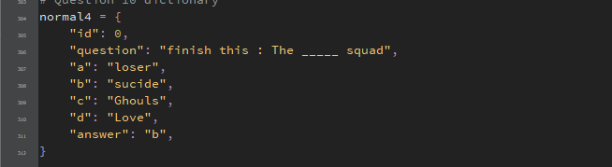
Dictionary 10

Slide 20
def
I used def which is when you define a function. How I used it was that I would def the code that would print the question and answers as this made it easier for when I change something so instead of having to find the code around the and change it constantly and fix the indentation. I put it next to its dictionary making it easier in spotting mistakes in my code or just changing it.

Slide 21
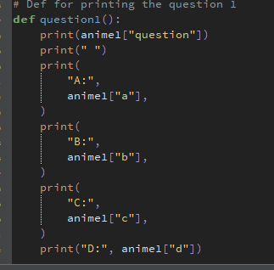
Def 1

Slide 22

Def 2

Slide 23

Def 3

Slide 24

Def 4

Slide 25

Def 5

Slide 26

Def 6

Slide 27

Def 7

Slide 28

Def 8

Slide 29

Def 9

Slide 30

Def 10

Slide 31
Error Handles, Score System, Questions
You also see this is where the code that prints out the quiz starts. It prints out def then asks for a response. I had put the user response as guess and I used .lower() to ensure that even when the response is in caps. This is because I made sure the answers were in lower
I then implemented error handles that ensure that the user has no complication with my code and that we don’t have it crashing. From 1 to 10, you can see that the error handles also known as loops. They are used to ensure that user only presses the four buttons. If they were to use a unknown key, it will immediately relap.The ‘Try Again’ is the final one where you would have to type “yes” or “no” again I ensured that it is only these two words. But I had to create a new dictionary to ensure that the code was not too simple.
Lastly is the score system which you can see as ‘counter’ will add a +1 to every correct answer while adding none to wrong answers. The source of the score is above the introduction

Slide 32
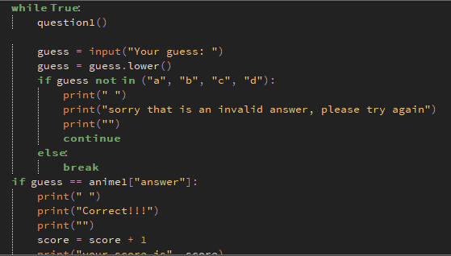
Error Handles, Score System, Questions 1

Slide 33
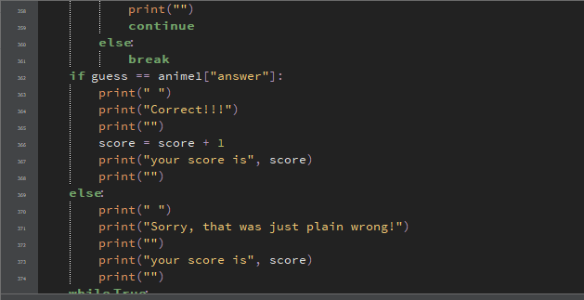
Error Handles, Score System, Questions 1

Slide 34
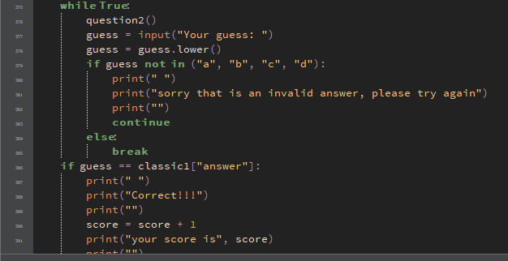
Error Handles, Score System, Questions 2

Slide 35

Error Handles, Score System, Questions 2

Slide 36

Error Handles, Score System, Questions 3

Slide 37

Error Handles, Score System, Questions 3

Slide 38

Error Handles, Score System, Questions 4

Slide 39

Error Handles, Score System, Questions 4

Slide 40
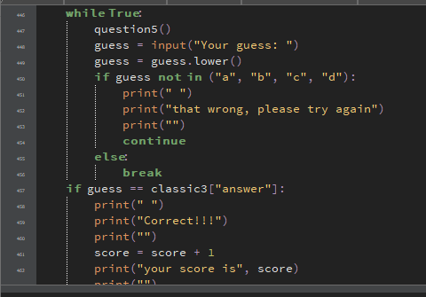
Error Handles, Score System, Questions 5

Slide 41
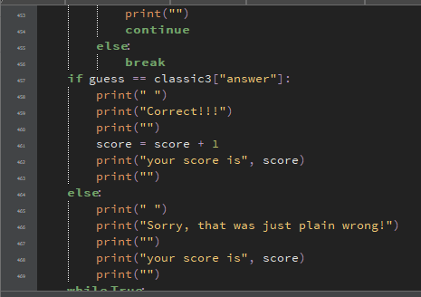
Error Handles, Score System, Questions 5

Slide 42

Error Handles, Score System, Questions 6

Slide 43

Error Handles, Score System, Questions 6

Slide 44

Error Handles, Score System, Questions 7

Slide 45

Error Handles, Score System, Questions 8

Slide 46

Error Handles, Score System, Questions 7

Slide 47

Error Handles, Score System, Questions 8

Slide 48

Error Handles, Score System, Questions 9

Slide 49

Error Handles, Score System, Questions 9

Slide 50

Error Handles, Score System, Questions 10

Slide 51

Error Handles, Score System, Questions 10

Slide 52
Error Handles, Score System, Questions 10

Slide 53
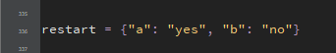
The Try Again Dictionary

Slide 54
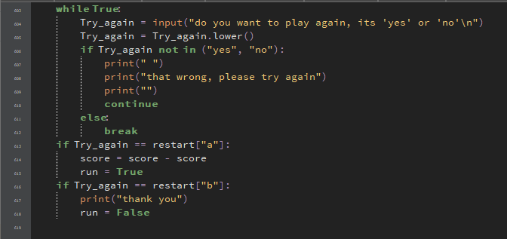
Error Handles, Score System, Try Again

Slide 55
Introduction
Here is the start to my quiz which my peers told me to do as most people had this feature in their codes so I inserted under my score counter. I had used the .uppercase() feature as I made a string where it asks for you for your name and it will reappear to either congratulate you or encourage you to try again.

Slide 56
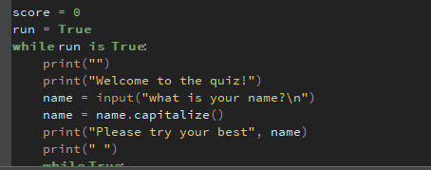
Introduction

Slide 57
Responses
I had made 3 responses that happen when player gets within a certain score limit which my family thought to be like the equivalent to like a game over screen but with a spin. These are a part of the scoring system.

Slide 58
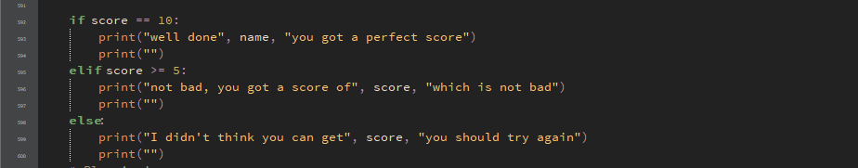
Response

Slide 59
Trialling components
Record evidence that you have trialled components. Show that you gathered information to inform your decision making.
Record evidence that you have trialled multiple components and have selected those most suitable.
Record evidence that you have used information from trialling appropriately to improve the functionality of the outcome.

Slide 60

Introduction

Slide 61
Questions and Scoring system

Slide 62
Error Handles

Slide 63
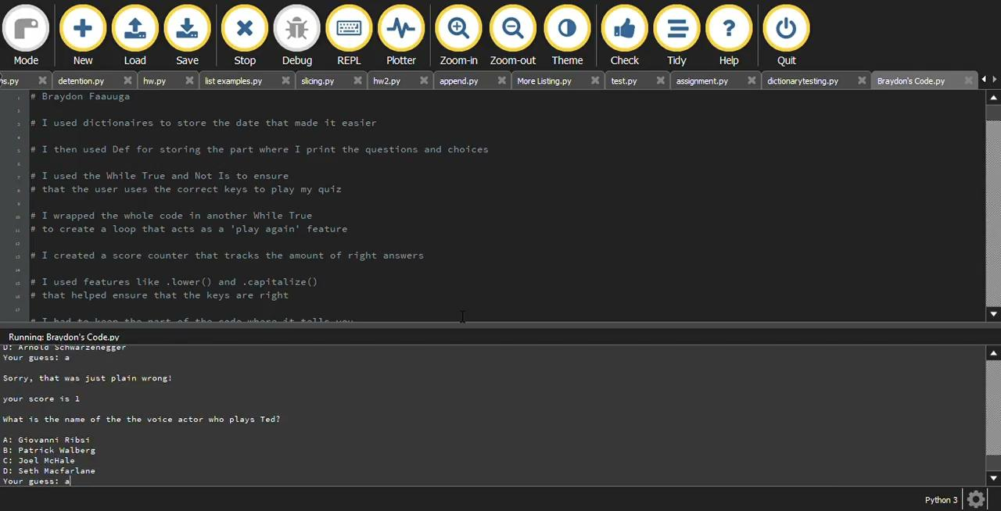
Try Again

Slide 64
Testing outcome
Record evidence that you have tested your outcome.
Explain how the testing made sure your outcome functions as intended to meet its purpose and requirements.
Record evidence that you have used information from testing appropriately to improve the functionality of the outcome.

Slide 65
Outcome Trial
Outcome Trial 1- here is the first trial of my quiz. As you can see that the quiz is nice and simple creating easy use for most ages. It also completes it intended task smoothly showcasing one of my ending response if the person was to get a perfect score.
Outcome trial 2- Here is the second Trial as this one would show error handles and the second response to the score system
Outcome trial 3 - Here is the last trial just to show the last response and try again feature
Outcome trial 4 - Just to go through all of my components all together

Slide 66
Version Control
Your version control evidence should go here. This could be in the form of annotated screenshots which show you you managed this process or you could make a brief screencast explaining how you implemented version control.
These are screenshots that I have gotten as I had put a previous version on different code scripts. When I had this version, it would not read the score system due to the score counter being in the actual def therefore it stops it continuing. It didn’t have .capitalize() and I didn’t add the try again and error handles.

Slide 67
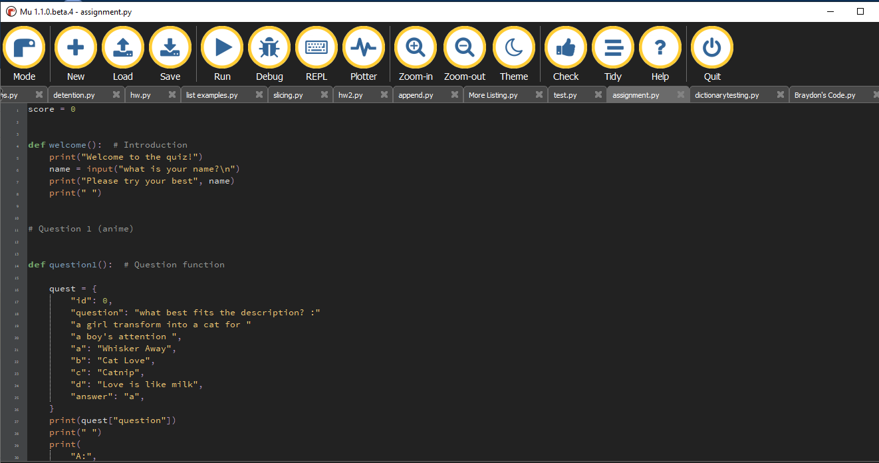
Version Control 1

Slide 68
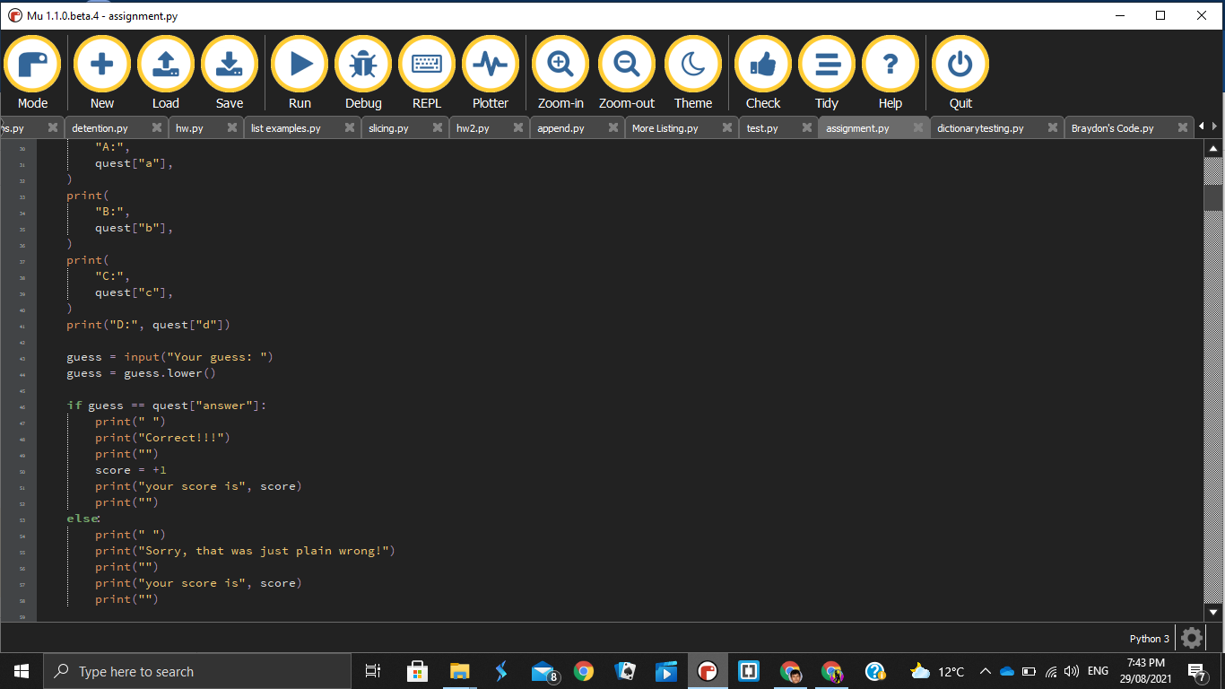
Version control 2

Slide 69
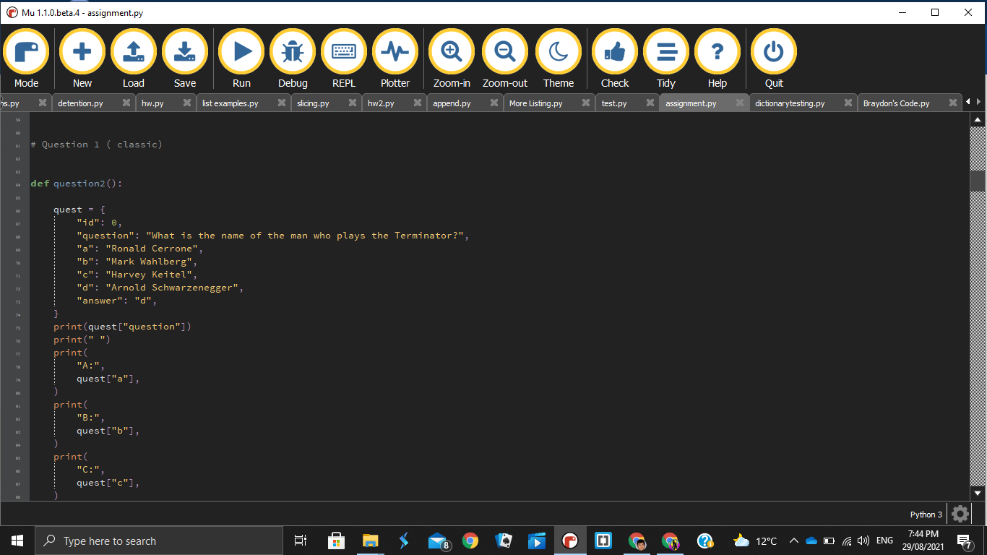
Version control 3

Slide 70
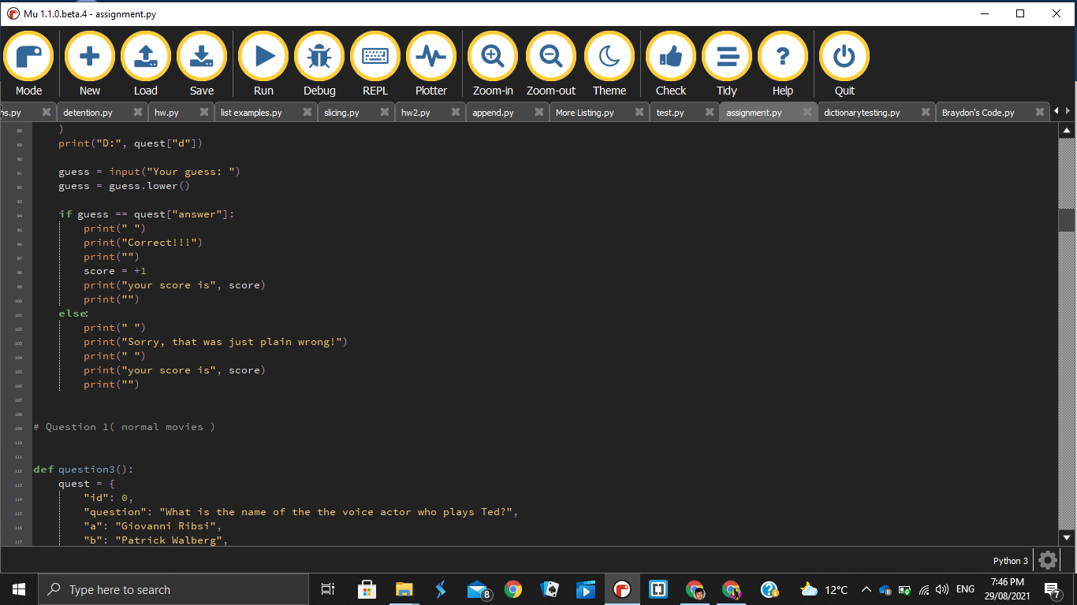
Version control 4

Slide 71
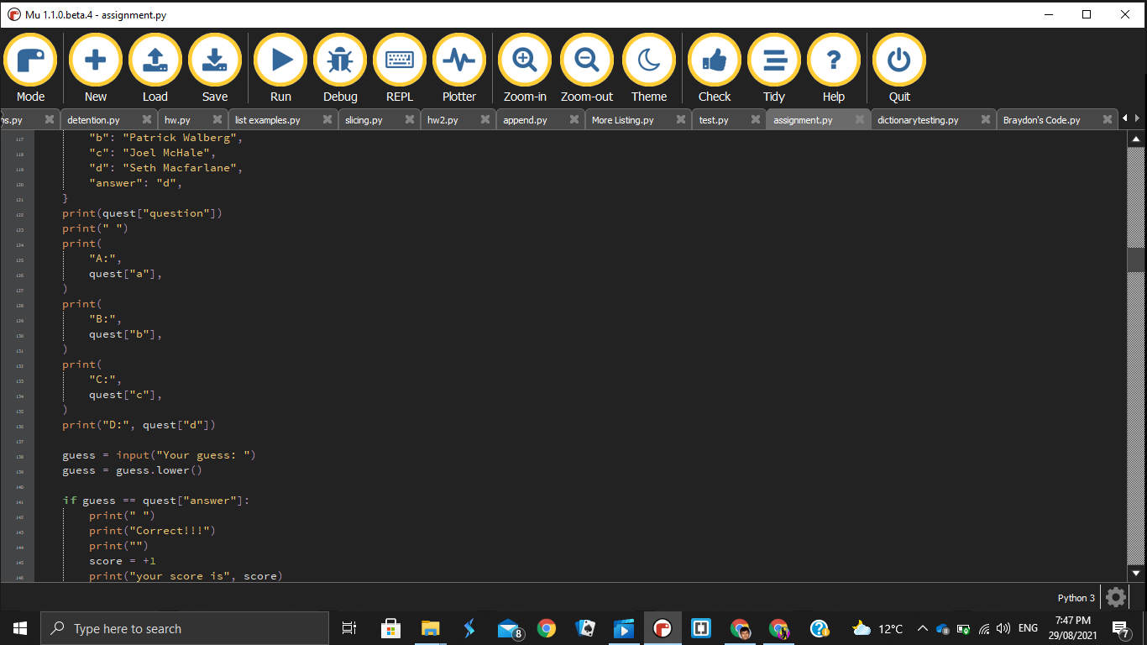
Version control 5

Slide 72
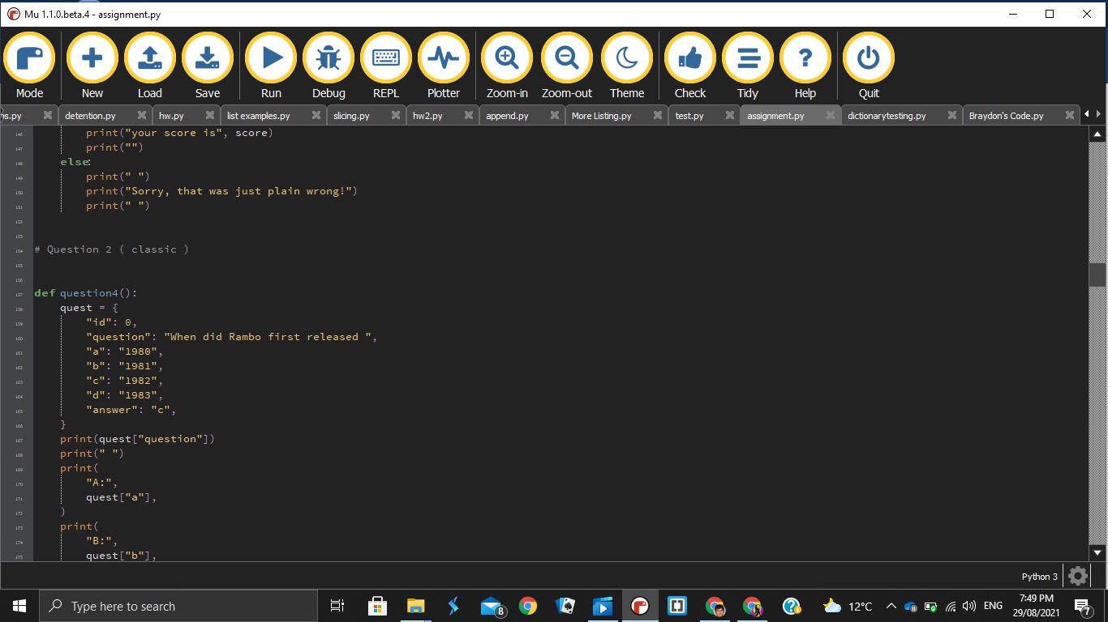
Version control 6

Slide 73
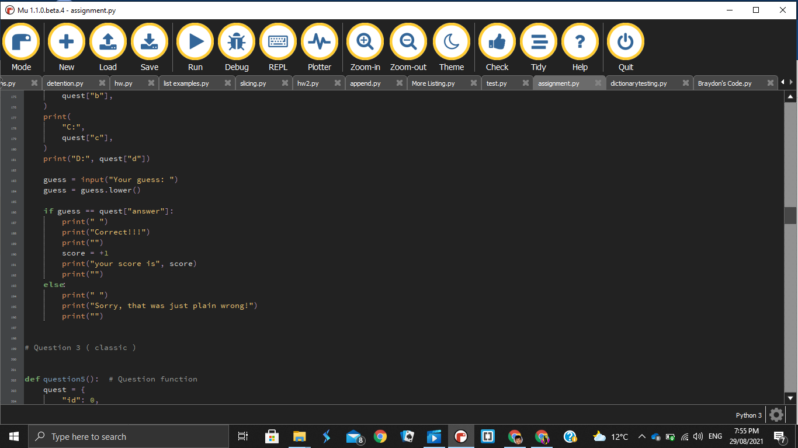
Version control 7

Slide 74
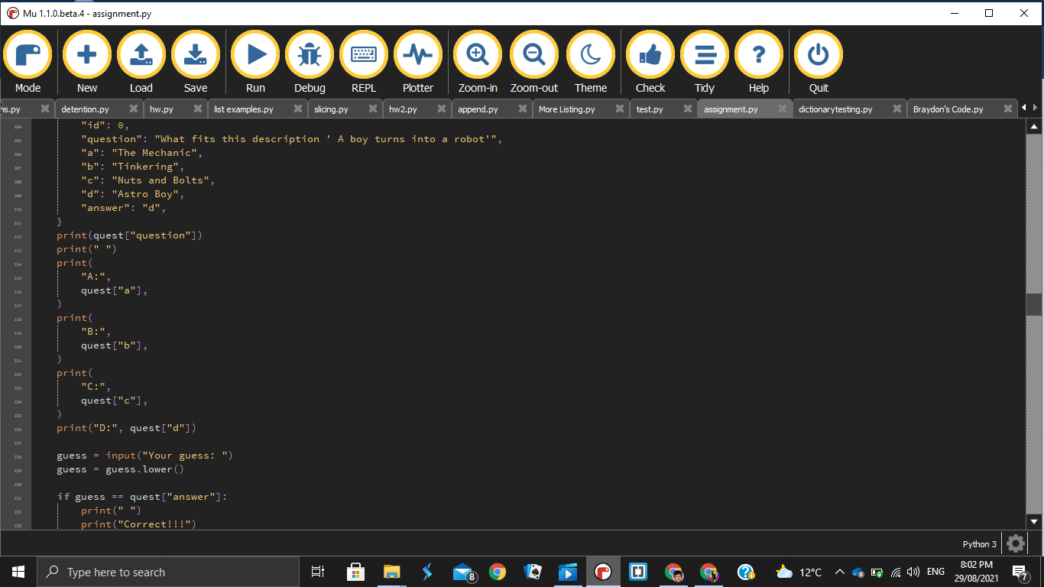
Version control 8

Slide 75
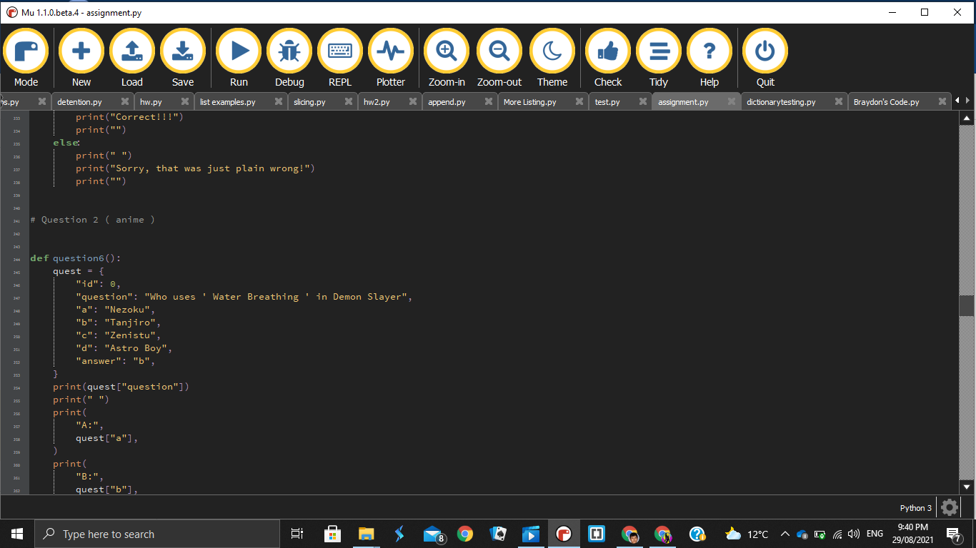
Version control 9

Slide 76
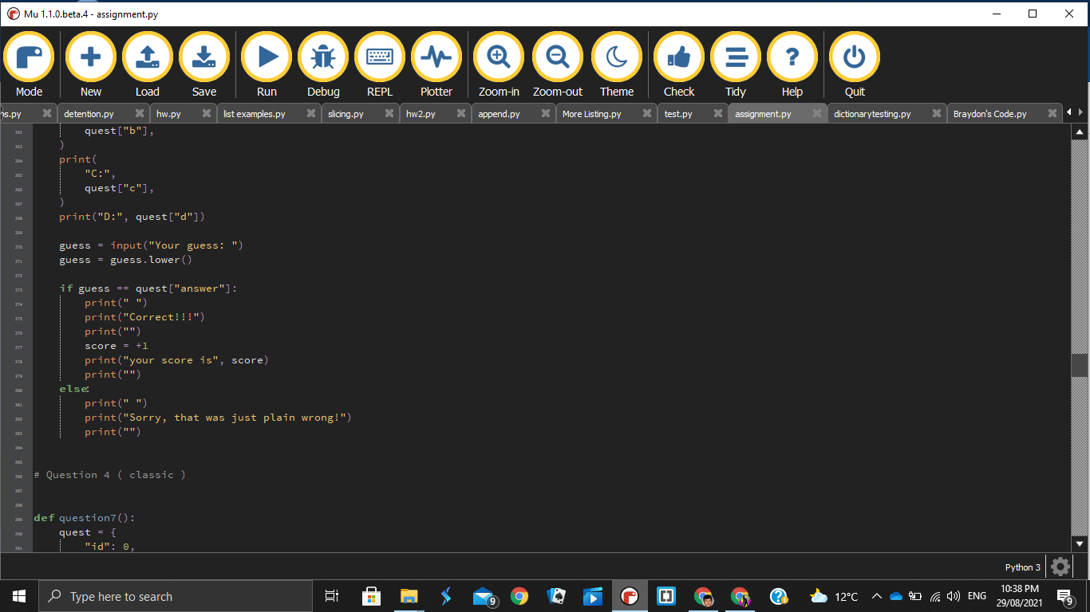
Version control 9

Slide 77
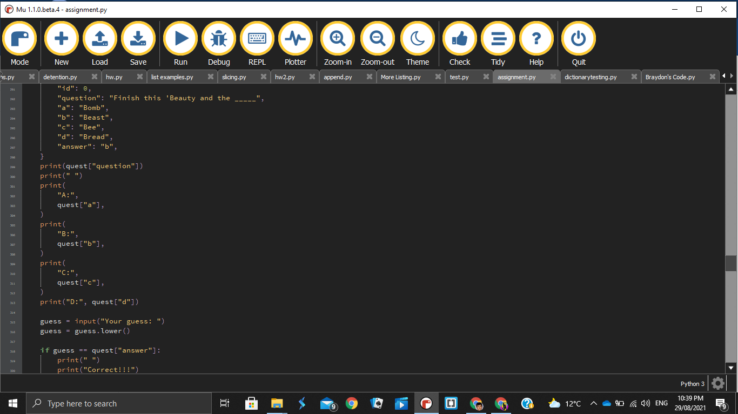
Version control 10

Slide 78
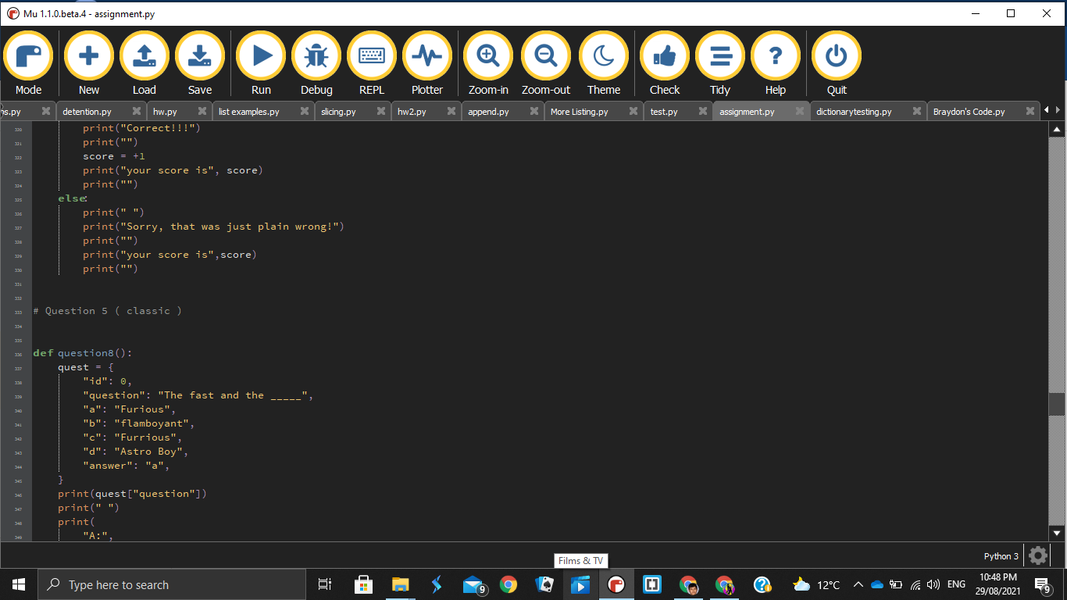
Version control 11

Slide 79
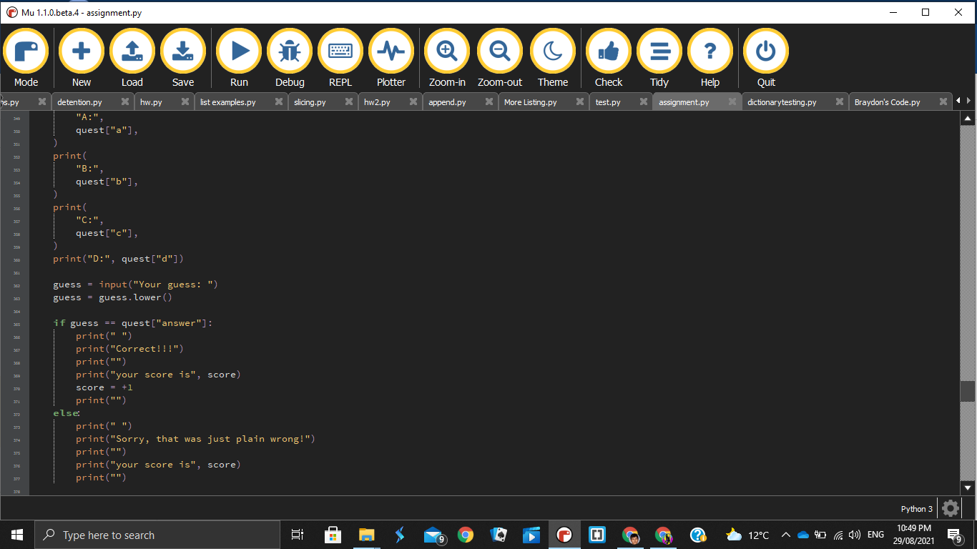
Version control 12

Slide 80
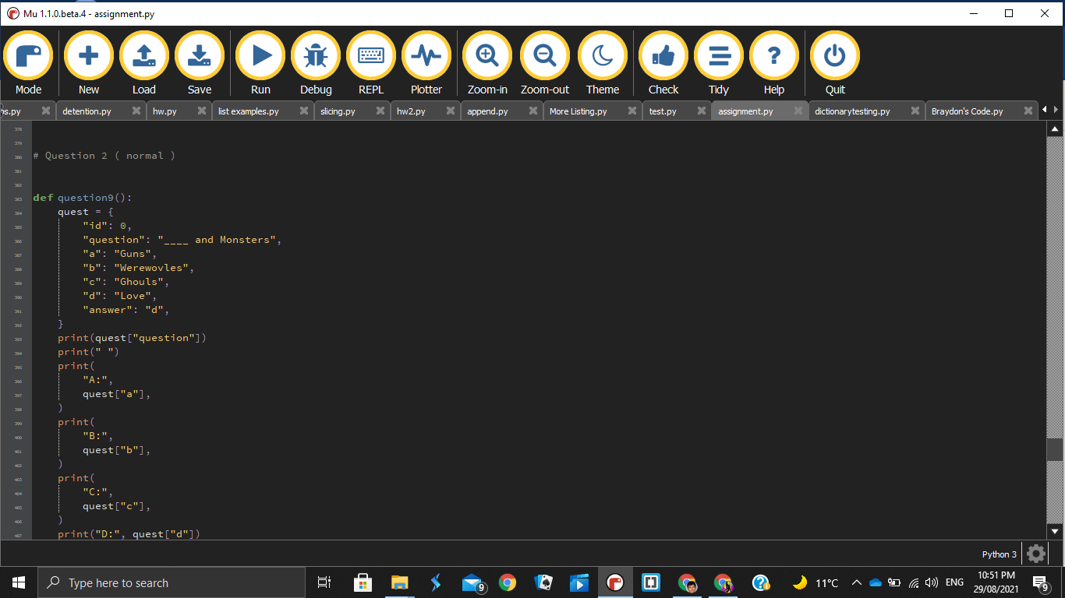
Version control 13

Slide 81
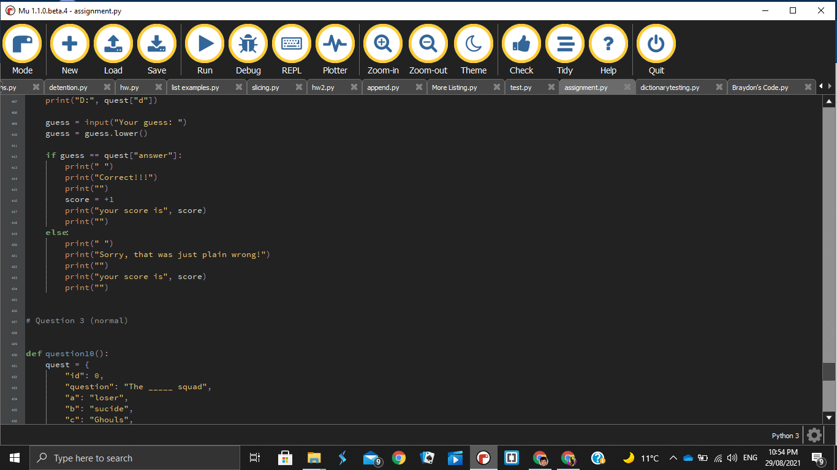
Version control 14

Slide 82
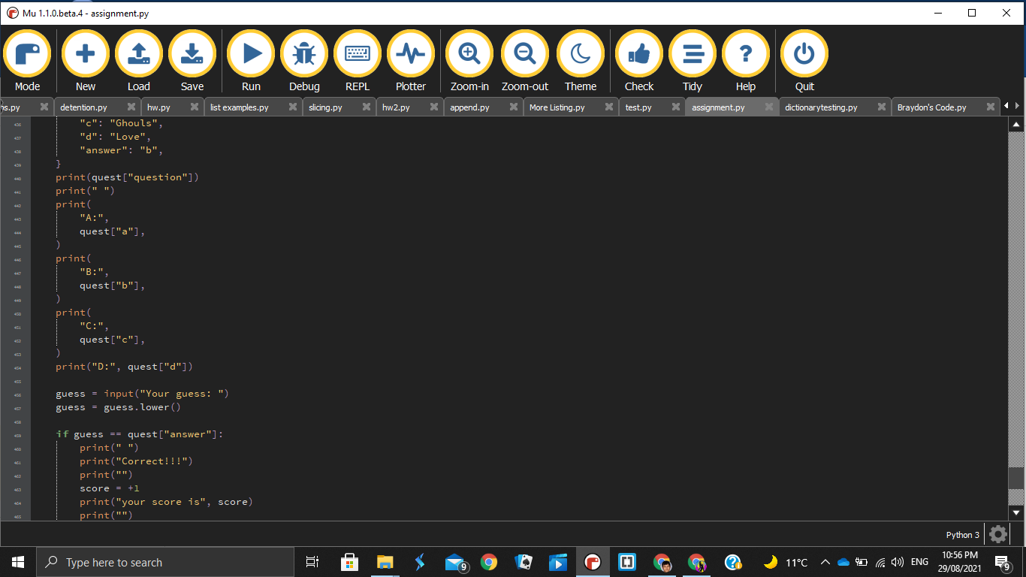
Version control 15

Slide 83
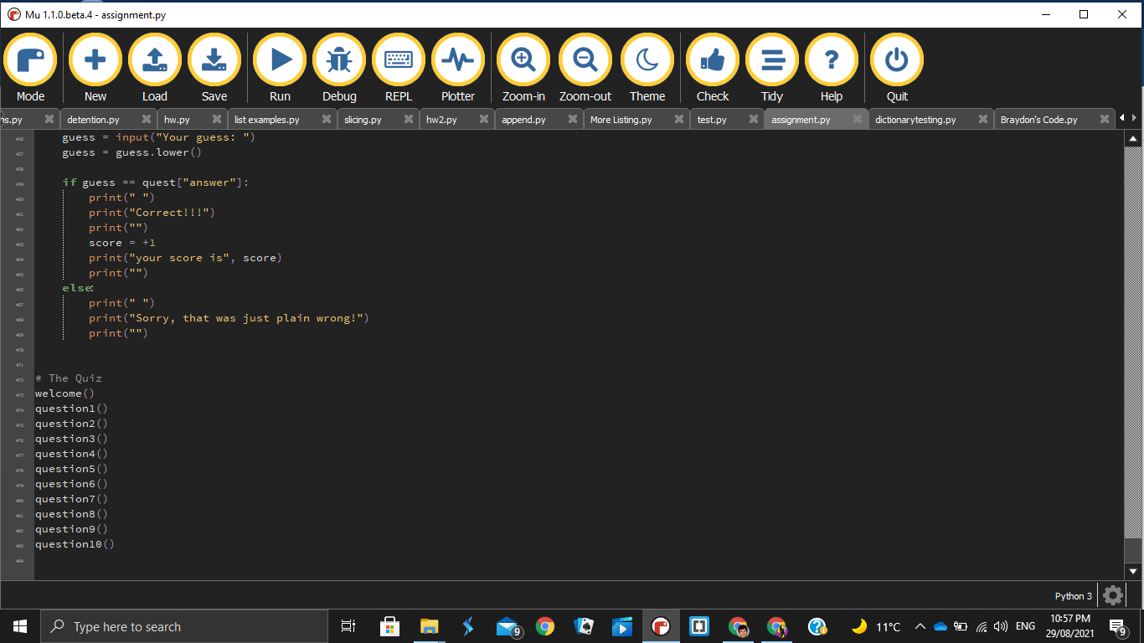
Version control 16

Slide 84
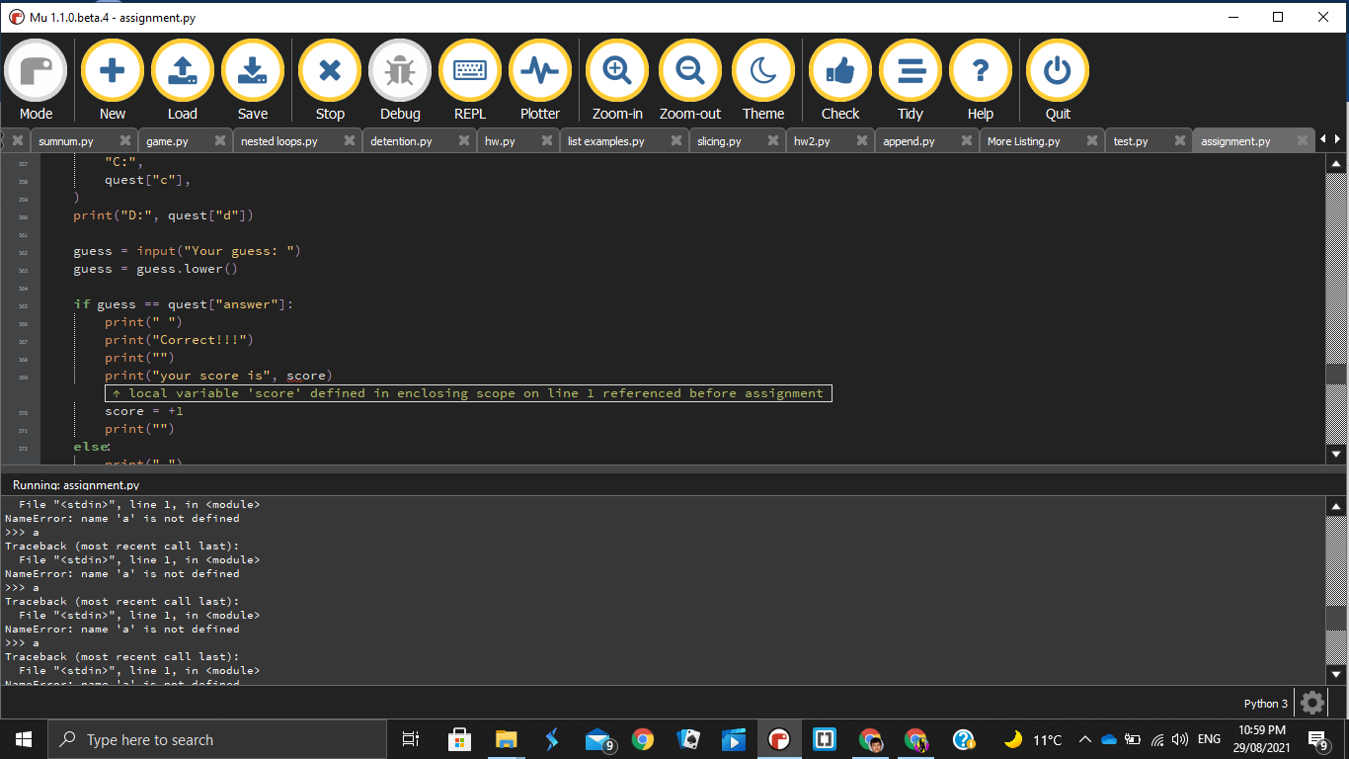
Version Control 17

Slide 85
Relevant Implications
Explain the relevant implications here. Please watch this video to learn how to do this.
Explain the Implications that are relevant to your outcome.
Record evidence that you have addressed the Implications that are relevant to your outcome.

Slide 86
Functionality
Functionality is the website ability to do its intended outcome.This is important as it is something that questions whether the project works or not. In reality that this can instantly cause problems such as loss in customers, sponsors or bankruptcy. This is why companies from scientists to plumbers, we all test the functionality of our products. Some have found where their product has somehow cheated this implication such as listerine which may be known as our well known mouthwash but it was intentionally used as a surgical antiseptic, gonorrhea and foot washing.
My code does what it is intentionally meant to do which is to make a quiz about different types of movies. It asks questions and this is great as it is not only the intended outcome that I wanted but It shall attract people who want to test themselves as this should be a good test of knowledge about movies or just want to have fun

Slide 87
Privacy
Privacy is asking about a project’s respect of an individual’s personal information. This is a implication that his highly recommended as personal information is now dangerous when exchanged. When someone personal info gets out to random people, this can lead to your accounts getting hacked. The least problematic in my opinion is when a social media account gets hacked. The reason is because most people just create a new one. It truly becomes problematic when the hackers goes into bank accounts. Most people scam them into giving them their private details by insisting that they would get a ‘too good to be true deal’.
In my quiz, it will ask for a name for the user to just call them by which will then display at the ending either congratulating them or telling them that they should either try their luck again. After that it automatically deletes it for the next user

Slide 88
Usability
Usability is the code ability to be flexibility, user freedom and error prevention. Meaning that if there is a problem in my code . This is important as it goes in hand with functionality. The reason is because even though a product works, a user will make a mistake which will cause the product fail. This can be seen in games where game developers has a character fall into a predicament where the character falls into a tight spot. It can’t get out yet the game still runs, most users just deal with this by restarting but it is still annoying for mistakes like that to happen. In a game like ‘Ghost of Tsushima’, we see this example though the developers has found a way to recognize this error. Therefore they implemented a code that sends the character to a safe location.
In my code I have implemented error handles when answering the questions.This helps any users from creating problems in my quiz that can cause the crash. By creating the code to only respond to certain keys which is just ‘a’, ‘b’, ‘c’ and ‘d’ as my questions are multi - choice questions. If they were enter the wrong key, my code will respond with “that’s wrong, please try again” and I did again when I asked the user if they would like to play again.

Slide 89
Health and Safety
Health and Safety is about the care of the user. When companies create product, they come with their own risks. These are important to note to users because without them, there will be consequences. Nowadays games has a lot of features such as constant flashing. We should be considerate of this as users can strain the eye which isn’t good. The worst case scenario is that it causes a seizure. If a product was scary, it would be advised that you shouldn’t show it to that faint of heart as they can have a heart attack.
My code is relatively simple meaning that I have no images or features that has rapid flashes which can cause someone to have an elpillitic seizure and that has no frightening images that can cause a person to have a panic attack

Slide 90
Evaluate
My planning was extremely helpful as being flexible is a wonderful ability in project management. Monday.com use of the Kanban method helped me with time even though I had a problem with time due to other studies that I had which made time more limited. When I did each task and graded myself. That was great as it also served as reminder for which task I should specifically focus on. There was also my lack of knowledge of dictionary so planning to use some of my days was put to good use. As one of my idea was to use .pop() to delete one of the possible answers. This was cut since you are actually unable to use it the way I wanted to. Planning for questions was the easy since I had thought out which movies and made a quiz before. So making questions up was short and simple.
When it came to trialling my components, it was actually easy since I made easy dictionary template that I used for all my questions and I had used def before which therefore made it easier to use. This made the code more compacted and easier to understand. The problem started when I tried to lay out a scoring system as when I first tried it, it didn’t register. I then found out that putting the score counter in the def stops it from registering. This was quite annoying due to the indentations that were needed. Then I started to code a loop that ensures that my quiz doesn’t crash due to a simple mistake. At first I thought I had it as my friend showed me how he did his but for some reason it didn’t work. That was until I showed it to him again and I had made a simple mistake. I had the wrong indentation. Then it said undefined name which I then found out I just made a mistake with spelling. The try again was the most annoying task as when trialling it I had thought I somehow broke my code. Yet the only problem was that my indentations were off and what made matters worse was when I did fix the indentation for it to repeat the questions, I didn’t include the response therefore it consumed more time. But thanks to constantly trying that I managed to do it.
Overall when I look back to this, Planning had help me create extra time when I needed it . Thanks to constant trials and testing, I was able to correct the mistakes and learn new things when it came to coding.

